Slide 1
W4111 – Introduction to Databases Section 002, Fall 2021
Lecture 1: Introduction and Foundational Concepts (V1.0)
© Donald F. Ferguson, 2021

Slide 2
W4111 – Introduction to Databases Section 002, V002; Spring 2022
© Donald F. Ferguson, 2021

Slide 3
W4111 – Introduction to Databases Section 002, Fall 2021
Lecture 1: Introduction and Foundational Concepts (V1.0)
We will start in a couple of minutes
© Donald F. Ferguson, 2021

Slide 4

W4111 Introduction to Databases:
Faculty do not manage waitlists for some courses, including W4111.
The academic admin staff in the CS Department manages the waitlist, priorities and enrollment.
4 | COMS W4111_002_2021_3: Lecture 1: Introduction, Course Overview, Foundational Concepts © Donald F. Ferguson, 2021

Slide 5
Today’s Contents
5 | COMS W4111_002_2021_3: Lecture 1: Introduction, Course Overview, Foundational Concepts © Donald F. Ferguson, 2021

Slide 6
Contents
The material is mostly
History of databases
Motivation for databases
Terms
Concepts
Covering in lecture is not a good use of time.
Just read slides that come with book. https://www.db-book.com/db7/slides-dir/index.html
Introduction
Logistics, about your instructor, OHs, TAs.
Changes from prior semesters based on student feedback.
Homework, exams.
Introduction
Introductory concepts: data, databases, database management systems.
Examples: Gives you a feel for programming and non-programming projects, applications, application architectures.
Database design, Entity-Relationship Model (Part 1)
Database design process.
ER-Model and diagrams.
The theory: The Relational Model (Part 1)
Relational model, schema, keys, schema diagrams.
Basics of relational algebra.
The realization: Structure Query Language (SQL) (Part 1)
Basics of Data Definition Language.
Basics of Data Manipulation Language (Query).
Homework 0 – Definition and discussion.

Slide 7
Introduction
Logistics Changes Based on Feedback
Exams, Homework
7 | COMS W4111_002_2021_3: Lecture 1: Introduction, Course Overview, Foundational Concepts © Donald F. Ferguson, 2021

Slide 8

Logistics
8 | COMS W4111_002_2021_3: Lecture 1: Introduction, Course Overview, Foundational Concepts © Donald F. Ferguson, 2021

Slide 9
Waitlist
The administrative staff of the Dept. of Computer Science directly manages enrollment in the W4111 sections and the wait lists. This is true of several courses.
COMS W4111 is ALWAYS oversubscribed and has huge wait lists.
The course is a requirement for several majors and tracks.
There are complex rules about prioritizing students for course enrollment, and also which students can take the hybrid section.
Faculty follow department policies and do not manage waitlists, despite the list that identifies the waitlist as “Instructor Managed.”
Contacts: You must work with administrative leaders on enrollment: Computer Science: Cynthia Meekins, cynthia@cs.columbia.edu)

Slide 10
Lecture Format, Recitation, Office Hours
Sessions:
Lecture: (In-Person) Lecture: Friday, 10:10 to 12:40
Recitation: Periodic, optional recitation on Saturday, 10:00 to 11:30.
Either in-person/online or just online. Will announce in advance.
Usually held when there is student interest, homework due, exams, etc.
Office hours:
In-person: Friday: 0830 to 1000, 4:00 PM – 6:00 PM; and by-request as needed.
Extra office hours: I hold a lot of extra office hours, usually based on workload around assignment due dates and exams.
I will be on campus when possible for students that want to speak with me or need more focused help.
Many of the extra OHs will be online only.
Collaboration/contact:
We will use Ed Discussions, which is available from CourseWorks. This replaces Piazza.
I am usually monitoring Slack. Subscribe to the channel #w4111-f21.
The course lectures, sample code, etc. will be in a GitHub repository.
The course website provides additional information.
Note: Your health, safety and well-being are ALWAYS my primary concern. These are bizarre, stressful times. Speak to me if you need special considerations and I will do the best that I can.

Slide 11
About Your Instructor
11 | COMS W4111_002_2021_3: Lecture 1: Introduction, Course Overview, Foundational Concepts © Donald F. Ferguson, 2021

Slide 12

About your Instructor
35 years in computer science industry:
IBM Fellow
Microsoft Technical Fellow.
Chief Technology Officer, CA technologies.
Dell Senior Technical Fellow.
CTO, Co-Founder, Seeka.tv.
Ansys Fellow
Academic experience:
BA, MS, Ph.D., Computer Science, Columbia University.
Approx. 15 semesters as an Adjunct Professor.
Professor of Professional Practice in CS (2018)
Courses:
E1006: Intro. to Computing
W4111: Intro. to Databases
E6998, E6156: Advanced Topics in SW Engineering (Cloud Computing)
Approx. 65 technical publications; Approx. 12 patents.
Personal:
Two children:
College freshman (Ithaca College).
2019 Barnard Graduate.
Hobbies:
Krav Maga, Black Belt in Kenpo Karate.
1LT, New York Guard.
Bicycling.
Astronomy.
Languages:
Proficient in Spanish.
Learning Arabic.

Slide 13
About the Course
13 | COMS W4111_002_2021_3: Lecture 1: Introduction, Course Overview, Foundational Concepts © Donald F. Ferguson, 2021

Slide 14
The Course
From the new/pending Columbia University Bulletin "Prerequisites: COMS W3134, COMS W3136, or COMS W3137; or the instructor's permission. The course covers what a database system is, how to design databases effectively and in a principled manner, how to query databases, and how to develop applications using databases: entity-relationship modeling, logical design of relational databases, relational algebra, SQL, database application development, database security, and an overview of query optimization and transaction processing. Additional topics generally include NoSQL, graph, object-relational, and cloud databases, as well as data preparation and cleaning of real-world data. The course offers both programming and non-programming paths for homework and projects, to accommodate students with different programming skills and backgrounds."
Prerequisites:
COMS W3134, COMS W3136, or COMS W3137 are data structures classes. All of these courses require extensive programming, in Java.
A course in data structures is helpful for this section of W4111 but not essential. I waive the requirement.
We will help you with any data structures knowledge you lack.
Programming in/for this class:
There will be a "non-programming" option, which we will discuss below.
For students who want to take the programming track, we will use Python. I will provide motivation for choosing Python below.

Slide 15
Course Objectives
Have fun, learn a lot and come to appreciate and enjoy some amazing technology. Data and databases have and will change the world.
Provide a foundation that allows you to succeed in future courses. This is an introduction to databases. The technology is crucial for future courses
Big data, data analysis, data science
Advanced database classes
Machine learning
Numerical and data analytics in operations research, engineering, economics, finance, life sciences, financial engineering, medicine, etc.
Enable you to successfully apply the technology in your work and profession.
Have cool stuff to talk about on interviews and in your resumes.

Slide 16
The Course – Value and my Perspective
This course is foundational, and will teach you the core concepts in
Data modeling
Data model implementation; Data manipulation.
Different database models and database management systems.
Implementation and architecture of data centric applications and database management systems.
ANY non-trivial application
Requires a well-designed data model.
Implements a data model and manipulates data.
Uses a database management system.
Understanding databases and database management is core to the “hottest fields” in computer science, e.g.
Data science
Machine learning
Intelligent (Autonomous) systems
Internet-of-Things
Cybersecurity
Cloud Computing
Database, database application, etc. skills are increasingly central to many disciplines, including:
Economics.
IEOR, financial engineering.
Mechanical and electrical engineering.
Medicine, pharmaceuticals
...
University courses on databases sometimes focus on theory and abstract concepts. This course will cover theory, but there will be an increased emphasis on:
Practical, hands-on applications of databases.
Patterns and best practices.
Developing and understanding database centric applications.
Using databases and various tools for data analysis, visualization and insight.
Personal perspective
A large percent of my career has been spent figuring out or leading teams that figured out how to model, implement and manipulate data.
I have used the information in this class more than anything else I have learned.
This will likely be true for you.

Slide 17
Surprising Example
Example: This is a photo of mean using a database during COVID-19 mobilization.
Match service members
To JTF-HQ requests for personnel
Based on assignment needs
And service member
Skills
Availability
Tracked in a DBMS.
The hardhat is because DB usage can be very dangerous 😱.
No joking: I had to build an application that used:
Relational DBMS.
Python, Jupyter Notebook.
Google Sheets with Apps Script.
Google Forms.
This technology and these skills are surprisingly applicable.

Slide 18
Modules
Each section of W4111 is slightly different based on student interest and professor's focus. There is a common, core syllabus. Professors cover topics in different orders and grouping based on teaching style.
This section of W4111 has four modules:
Foundational concepts (50% of semester): This module covers concepts like data models, relational model, relational databases and applications, schema, normalization, … The module focuses on the relational model and relational databases. The concepts are critical and foundational for all types of databases and data centric applications.
Database management system architecture and implementation (10%): This module covers the software architecture, algorithms and implementation techniques that allow databases management systems to deliver functions. Topics include memory hierarchy, storage systems, caching/buffer pools, indexes, query processing, query optimization, transaction processing, isolation and concurrency control.
NoSQL – “Not Only SQL” databases (20%): This module provides motivation for “NoSQL” data models and databases, and covers examples and use cases. The module also includes cloud databases and databases-as-a-service.
Data Enabled Decision Support (20%): This module covers data warehouses, data import and cleanse, OLAP, Pivot Tables, Star Schema, reporting and visualization, and provides and overview of analysis techniques, e.g. clustering, classification, analysis, mining.

Slide 19
Environment
19 | COMS W4111_002_2021_3: Lecture 1: Introduction, Course Overview, Foundational Concepts © Donald F. Ferguson, 2021

Slide 20
Course Resources and Development Environment
Recommended textbook:
Database System Concepts. Seventh Edition. (ISBN 9780078022159)
There is a website associated with the textbook: https://www.db-book.com/db7/
Textbooks are expensive. You can easily get through the course using website, lecture material, ... ...
Install a new, most recent, isolated/single user instance of Anaconda environment.
You must install the most recent version for Python 3.
You can isolate the new instance from other instances to avoid conflicts, or set up custom environments.
Development environments: Students. Are entitled to a free, annual JetBrains professional license.
Students have had problems with MySQL Workbench. We will try DataGrip. Please install.
Installing PyCharm is recommended for all and required for the programming track.
Install MySQL Service Community Edition.
When prompted, choose legacy authentication method.
Set your root password to dbuserdbuser

Slide 21
Changes from Previous Semesters
21 | COMS W4111_002_2021_3: Lecture 1: Introduction, Course Overview, Foundational Concepts © Donald F. Ferguson, 2021

Slide 22
Observations from Last Semester
Student evaluation:
I pay a lot of attention to students’ evaluations and comments.
Fall 2020 evaluations:
Course overall quality was 3.49 (out of 5). My past average has consistently been over 4.1.
Instructor overall quality was 3.66. My past average has consistently been over 4.1.
Some recurring (negative) themes:
“This is the most disorganized course I've taken.”
HW assignments are vague and unclear.
Too much work.
We will try to make improvements this semester.
Much, much better adherence to a HW and exam cadence/schedule.
We will make the HW assignments definitions clearer, but not as clear as you want.
Relying very heavily on the head TAs for homework/exam definition, explanation, ... ...
Will have periodic checkpoint polls to get feedback and change suggestions.

Slide 23
Homework Exams
Grading
23 | COMS W4111_002_2021_3: Lecture 1: Introduction, Course Overview, Foundational Concepts © Donald F. Ferguson, 2021

Slide 24
Assignments, Exams, Grading
Point value of assignments and exams
50%: Homework assignments:
4 HWs, approximately one HW every two-three weeks.
Each is worth either 10 or 15 points based on difficulty.
Homework format:
Common to all tracks:
Questions requiring written answers and diagrams.
Implement/execute/test various database operations required to solve a use case/question.
Format will be an iPython/Jupyter Notebook.
Track specific: Incremental development of a project:
Programming track – web application.
Non-programming track – data analysis/visualization.
You receive a total of five late submission days that you can use during the semester.
Exams: Both the midterm and final have an in-class and take-home element.
20% of grade is midterm exam score.
30% is final exam score.
97-100 points is an A. There are opportunities to get extra-credit.
All tracks will learn core concepts and get experience with other tracks’ focus topics.

Slide 25
To Program or Not To Program, ...
From the department's guidance for the course:
"To accommodate the diverse backgrounds of the students who take this class, all sections of the class should include a non-programming option for projects and assignments. We (NOTE: Does not include me) have successfully offered such an option in some sections of the class for many years: students can either program a web application to interface with a DB of their own design, or alternatively follow the non-programming option and come up with a quantifiably more detailed DB design/data.
What does not constitute programming?
Writing queries for a relational, graph, document, or other data management system does not constitute programming and can be expected of all students.
What constitutes programming?
Reading more than a handful (1-5) lines of code, Writing Python code that is not directly required to write a query."
Why I previous only did a programming track:
Any non-trivial use of data and databases in any field requires programming. This is not Star Trek. You cannot shout, "Computer! Analyze ..."
You might think, "But, I do not want to program. I want to go into financial services, private equity, medicine, ... I can just use tools like Pandas or Tableau”. You will do some programming in these jobs for complex scenarios. Get over it.
Tracks: Programming and non-programming.
There is a common core that involves understanding concepts, modeling data, using databases, etc.
Exams are the same for both tracks. Mix of written questions and practical exercises.
Homework assignments: There is a common core on all assignments for both tracks. Additionally,
Programming track will incrementally build a database centric, cloud-based web application.
Non-programming track will do a more complex, database centric project.

Slide 26
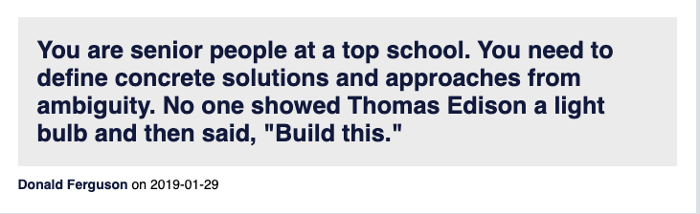
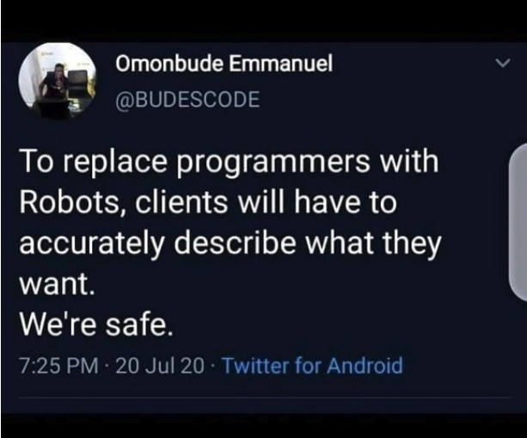
Homework Assignments
My homework assignments are:
Open ended.
Vaguely specified.
You will complain. I will listen sympathetically.
You will savage me on the instructor reviews and CULPA.
My professional colleagues and I will laugh at you behind your back.
Management, clients, partners, etc.
Do not understand technology as well as we do.
You will get requirements like, “I want it colored mauve because that has more RAM.”
Converting vague requests into a useful, meaningful project that we can implement is what we do. Get over it.
BUT, I WILL SIGNIFICANTLY IMPROVE CLARITY AND DETAILS.

Slide 27
Examples
27 | COMS W4111_002_2021_3: Lecture 1: Introduction, Course Overview, Foundational Concepts © Donald F. Ferguson, 2021

Slide 28
IMDB (Programming Track Example)
28 | COMS W4111_002_2021_3: Lecture 1: Introduction, Course Overview, Foundational Concepts © Donald F. Ferguson, 2021

Slide 29
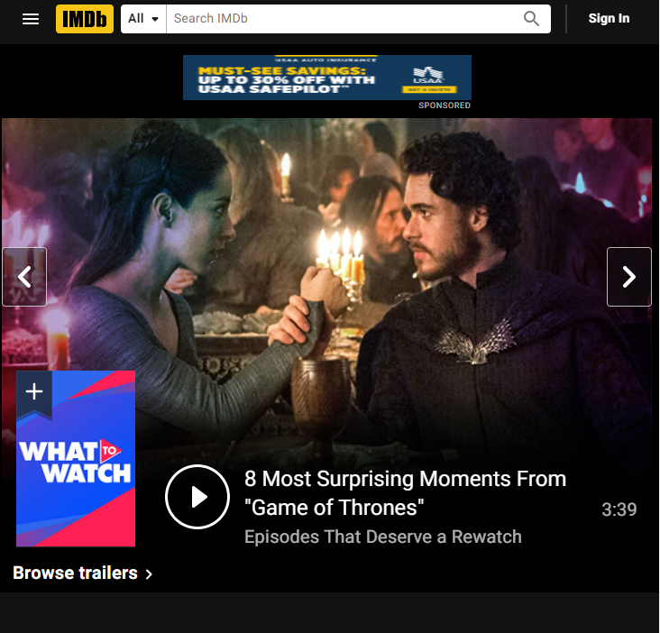
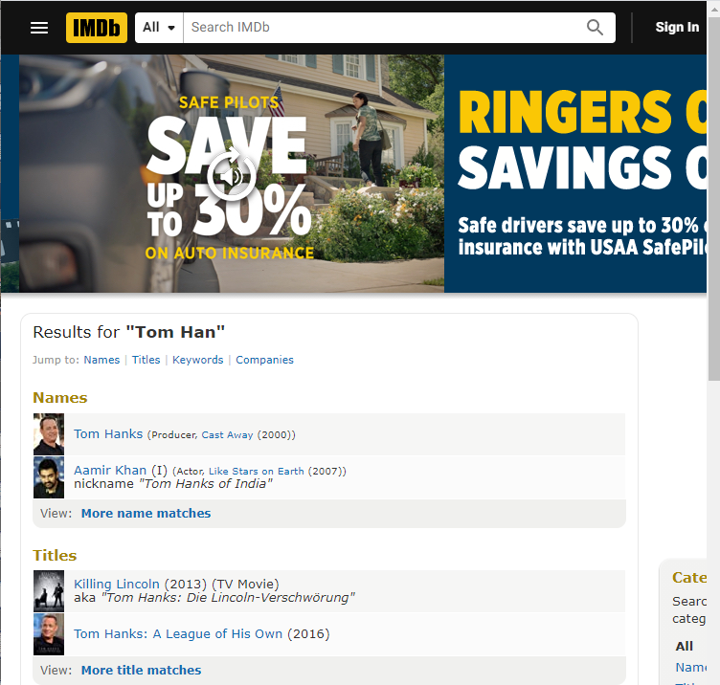
Most of Us are Familiar with IMDB
Type “Tom Han” in the search field.

Slide 30
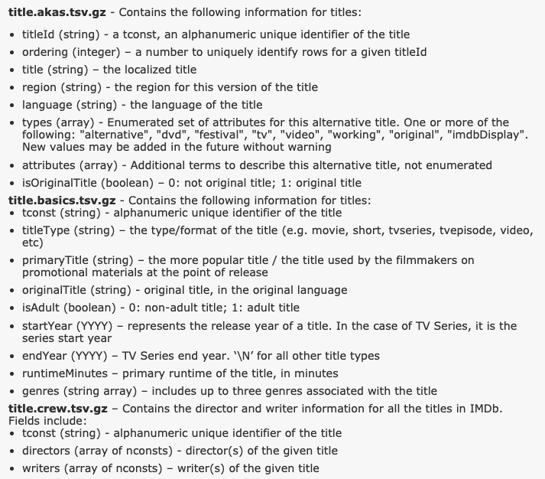
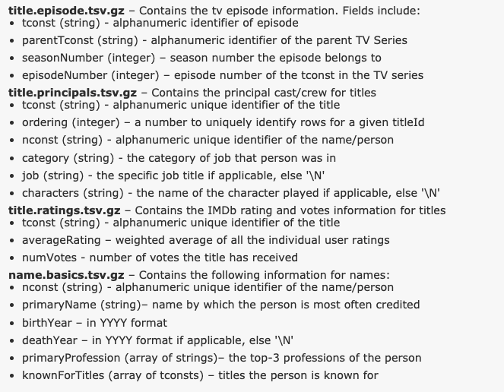
Downloadable IMDB Data
https://www.imdb.com/interfaces/

Slide 31
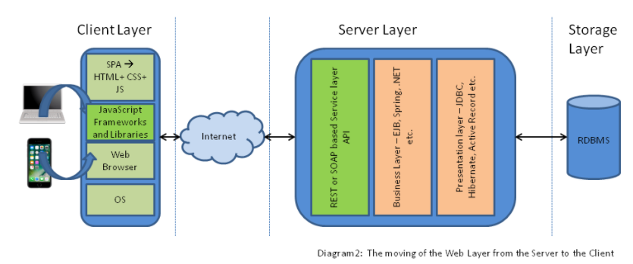
Conceptual Model – Application Architecture
https://dzone.com/articles/architectural-shift-in-web-applications-with-emerg
Browser client application with HTML, CSS, JavaScript, … …
Middle-tier server application:
Receives API calls from client application.
Implements application logic and makes database calls.
Returns result.
Database Management System receives DB calls and returns data.
This is a “full stack (web) application.”
Part of the programming track HW and projects is to build a full stack app.
Starting from a template I provide to simplify non-DB tasks.

Slide 32
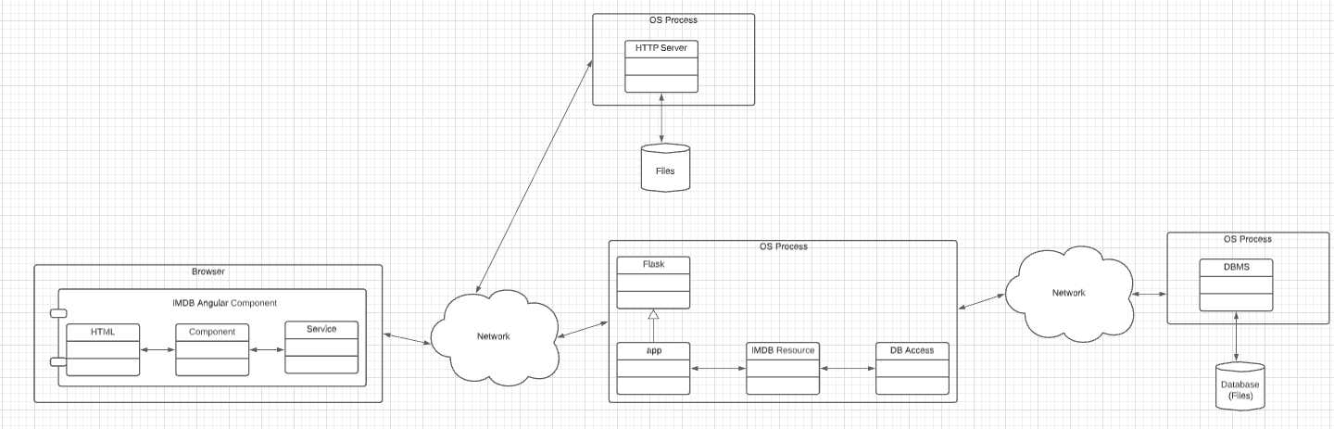
Explanation of Example Code
HTML, CSS, images, JavaScript
Angular, Bootstrap
IDE: WebStorm
Downloads using HTTP
REST calls to access data.
HTML, CSS, images, JavaScript
Delivers static content from files
https://github.com/donald-f-ferguson/demo-flask
https://github.com/donald-f-ferguson/demo-ui
Flask application server framework
Python application code
IDE: PyCharm
Interacts with database over network connection using SQL statements.
MySQL Community Server
Implements SQL operations
Maintains data in files
Notes:
Run demos
Show code

Slide 33
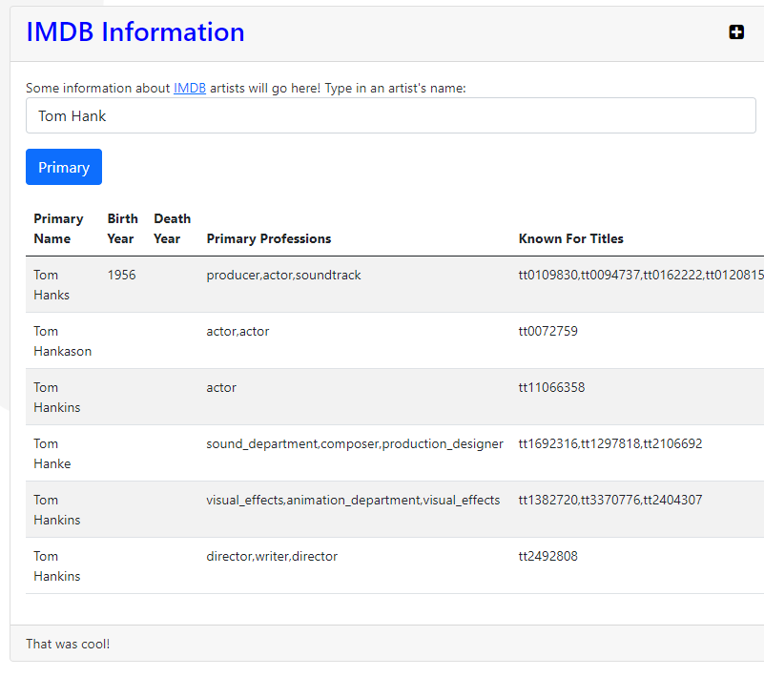
Switch to Demo
A Simple IMDB
Single page browser application.
Web application (server).
Database schema and query.
Show some code.
Browser
Python, Flask
SQL database
REST requests

Slide 34
Game of Thrones (Non-Programming Track Example)
34 | COMS W4111_002_2021_3: Lecture 1: Introduction, Course Overview, Foundational Concepts © Donald F. Ferguson, 2021

Slide 35
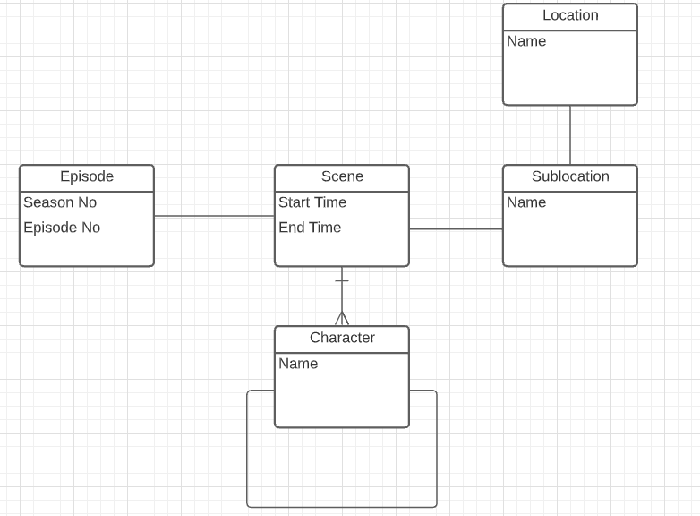
Games of Thrones
There are some interesting web sites and projects that analyze GoT. I used https://jeffreylancaster.github.io/game-of-thrones/
I had to download, process and cleanup, and load into a DB.
Structure
Seasons contain episodes.
Episodes contain scenes.
Scenes happen in a location.
Characters appear in scenes.
Character have interactions/relations
Marry
Kill
Protect
… …

Slide 36
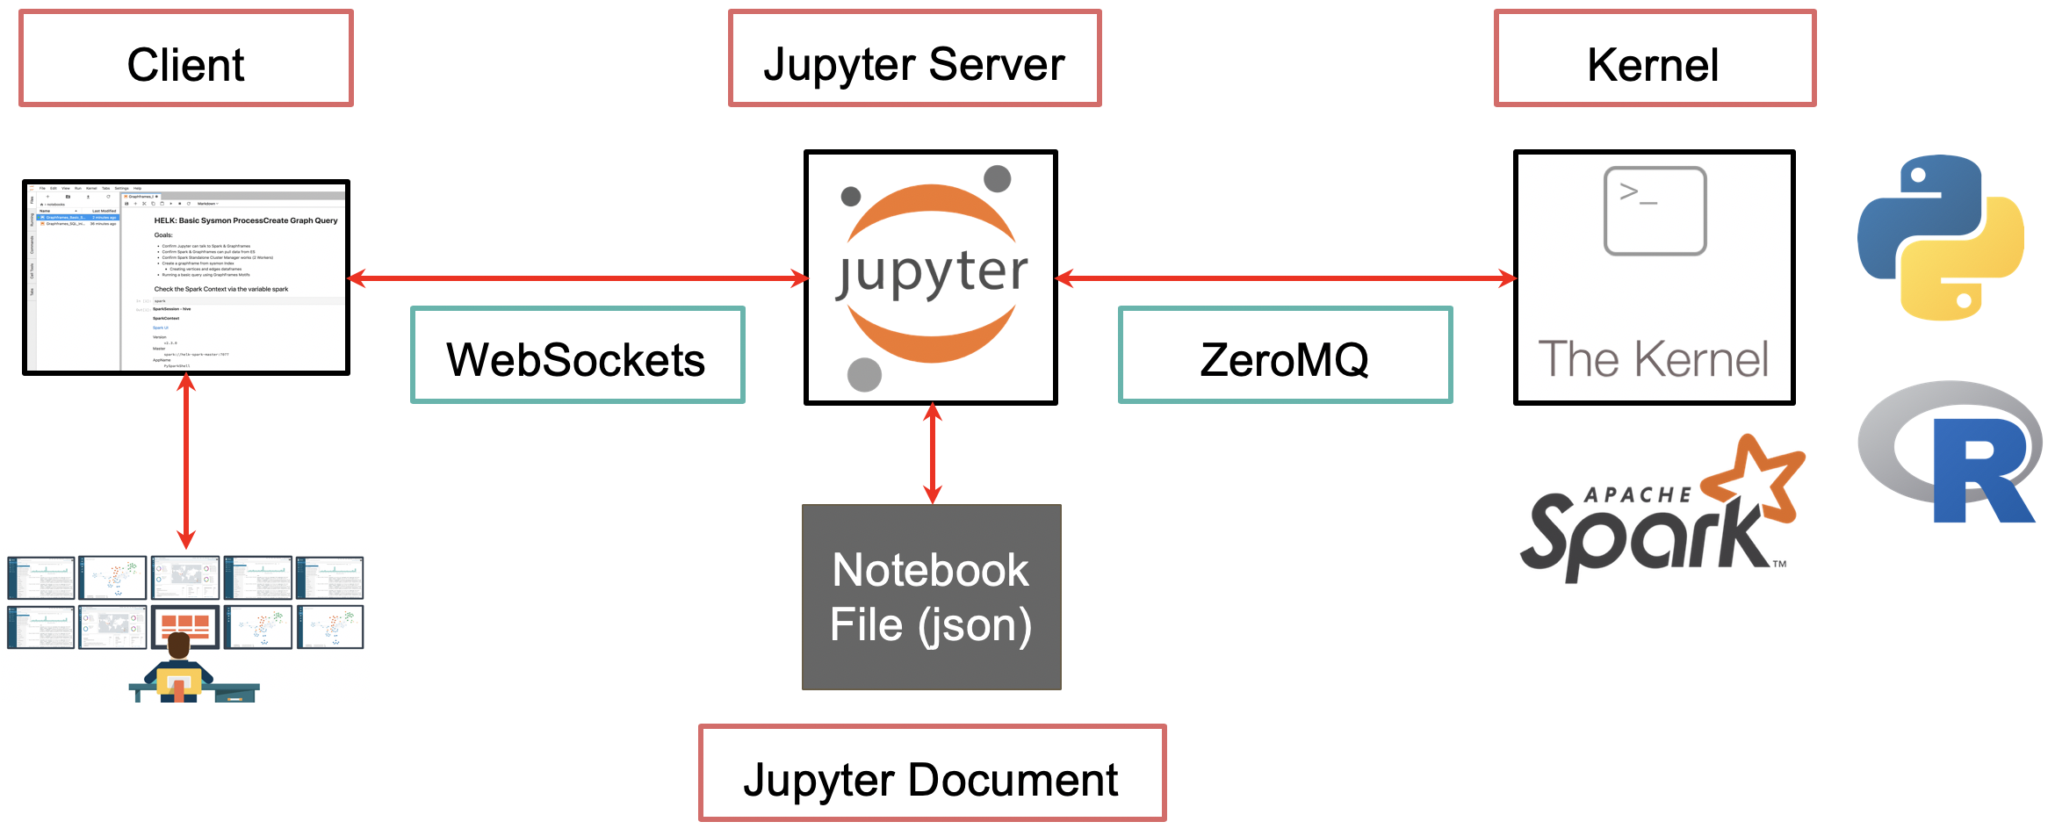

Data Analysis and Visual with Python
Jupyter notebook contains:
Text in Markdown cells to explain the document, content, conclusions, … …
Python code and library calls to access application/data, process information, etc.
Code executes on in a “server process” and accesses a database.

Slide 37
Switch to Notebook
Lectures/Lecture_1_Introduction_Foundations/NonProgrammingGOTExample.ipynb

Slide 38
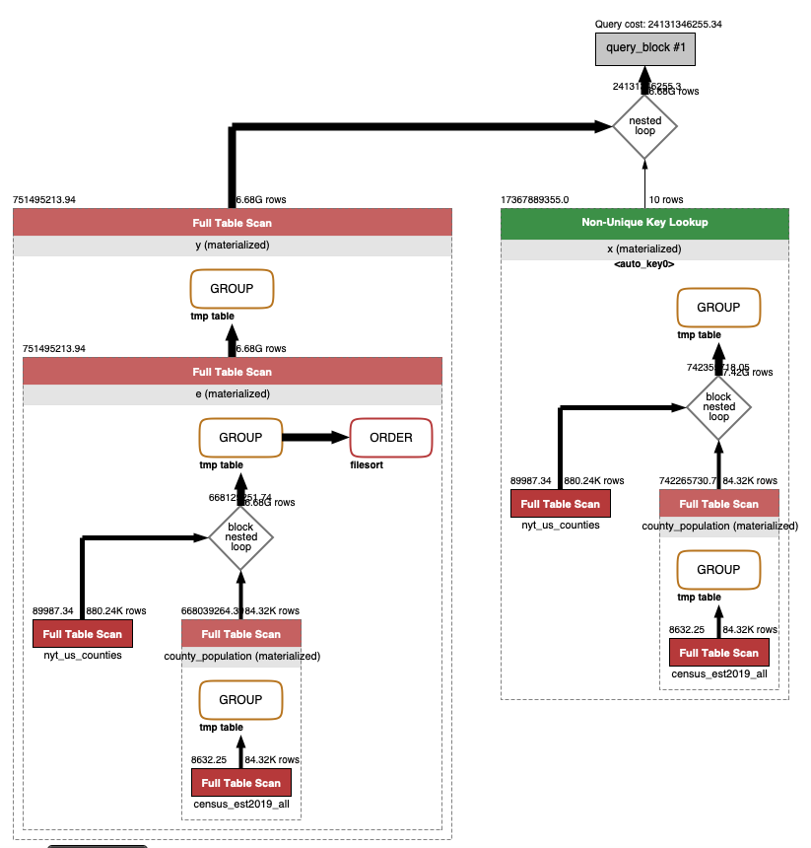
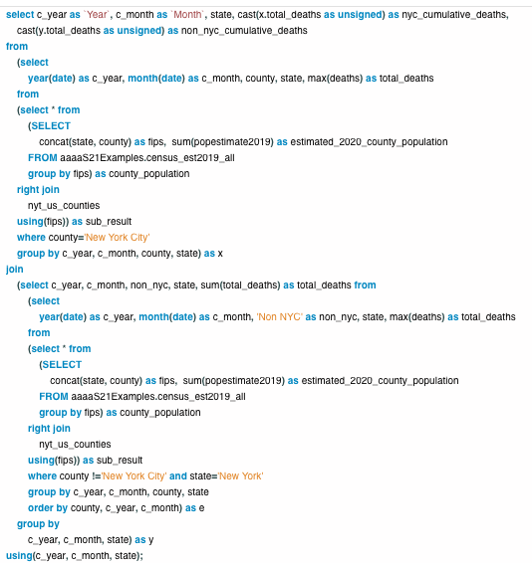
Data Sciences Uses Complex Queries
Database Engine
SQL seems complex. Once you learn SQL, it is more productive than hand writing code.
We will also see that the engine performs sophisticated performance optimizations.

Slide 39
Data Science (IEOR, Finance, …) Require Data Engineering
What you learn in data science, machine learning, etc. courses.
You got a sense of the essence of database and data.
Query languages.
Schema.
Operations on data.
Scale and performance.
And ...
Both programming and non-programming tracks will do work like what I just did.
The non-programming track does a lot more of it.
What you learn in
this course. Databases and Data Engineering
10% of the work is the cool data science, ML, … …
90% of the work is data engineering and query.

Slide 40
Data Cleansing
https://blog.amplitude.com/big-data-cleanup
Database and data science classes love to teach the fun stuff queries, data modeling, machine learning, spooky math, algorithms, ... ...

Slide 41
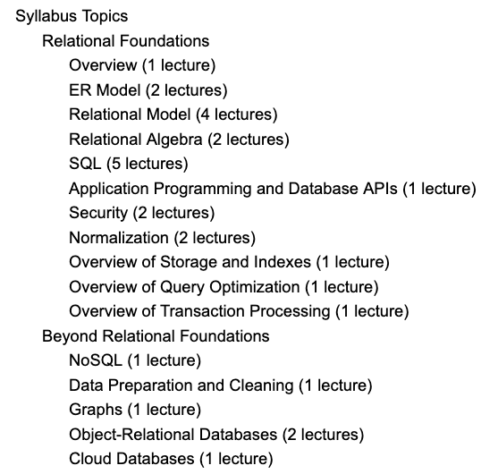
Data Cleansing
Recommended Syllabus
I place more emphasis on data cleansing and refactoring than other sections of W4111.

Slide 42
Approach for First Few Lectures
42 | COMS W4111_002_2021_3: Lecture 1: Introduction, Course Overview, Foundational Concepts © Donald F. Ferguson, 2021

Slide 43
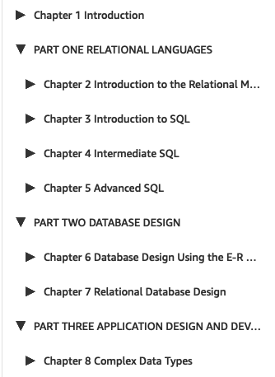
Lectures and Topics
Chapter 1:
Is interesting, but something easily learned from reading slides, docs, etc.
I can cover in OHs, recitation, Q&A, Piazza, ... ...
Books and standard syllabuses tend to be sequential. Cover and complete topics one at a time.
My view is that there is a core conceptual model with three realizations:
Entity, relationships, ... ...; the concepts.
ER design and modeling.
Implementation:
Relational model/algebra.
SQL.
Resource/REST oriented.
My approach is to incrementally and iteratively:
Introduce concepts.
Explain the realizations.
Because a implementing a real system requires the approach of concept, design, implement in several layers.

Slide 44
Core Concepts:
Data
Databases
Database management systems.
Applications, application architectures.
Roles.
History of databases.
etc.
Covering these topics is not a good use of lecture time:
Read the slides for chapter 1 from the recommended textbook. (https://www.db-book.com/db7/slides-dir/PPTX-dir/ch1.pptx)
We will cover the material through questions on the reading, recitation, Piazza questions, ... ...
44 | COMS W4111_002_2021_3: Lecture 1: Introduction, Course Overview, Foundational Concepts © Donald F. Ferguson, 2021

Slide 45
Database design, Entity-Relationship Model (Part 1)
Entity, relationship, attribute.
Database design process.
ER-Model and diagrams.
45 | COMS W4111_002_2021_3: Lecture 1: Introduction, Course Overview, Foundational Concepts © Donald F. Ferguson, 2021

Slide 46
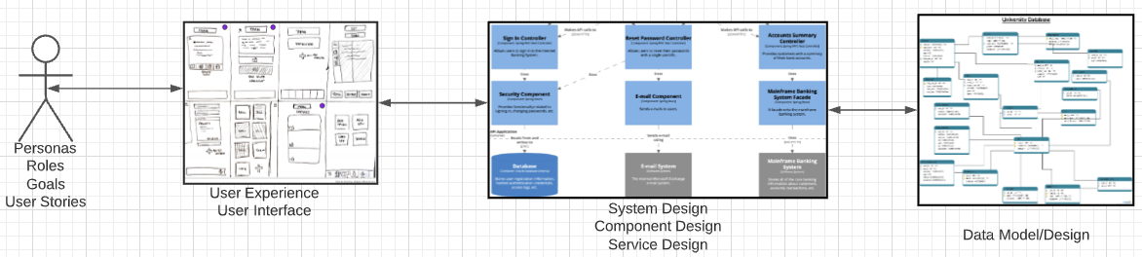
Problem Statement
We must build a system that supports academic operations in a university.
There are two major domains:
Interactive operations, e.g. register, choose class, assign grade, ... ...
Insight and reporting, e.g. enrollment trends, overloaded resources, ... ...
We will design, develop, test and deploy the system iteratively and continuously.
There are four core domains.
The processes are iterative, with continuous extension and details.
In this course,
We focus on the data dimension.
We will get some insight into the other dimensions.

Slide 47
Design Phases
Initial phase -- characterize fully the data needs of the prospective database users.
Second phase -- choosing a data model
Applying the concepts of the chosen data model
Translating these requirements into a conceptual schema of the database.
A fully developed conceptual schema indicates the functional requirements of the enterprise.
Describe the kinds of operations (or transactions) that will be performed on the data.
DFF Comments:
We you see slides with this formatting, the come directly from the presentations associated with the textbook. (https://www.db-book.com/db7/slides-dir/index.html)
The number at the bottom is of the form chapter.slide_no.
I try to put my comments, modifications and annotations in red text, or inside a red rectangle/callout.

Slide 48
Design Phases (Cont.)
Final Phase -- Moving from an abstract data model to the implementation of the database
Logical Design – Deciding on the database schema. Database design requires that we find a “good” collection of relation schemas.
Business decision – What attributes should we record in the database?
Computer Science decision – What relation schemas should we have and how should the attributes be distributed among the various relation schemas?
Physical Design – Deciding on the physical layout of the database
Notes:
48

Slide 49
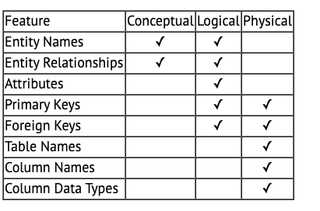
A Common and my Approach: Conceptual → Logical → Physical
https://ehikioya.com/conceptual-logical-physical-database-modeling/
https://www.1keydata.com/datawarehousing/data-modeling-levels.html
It is easy to get carried away with modeling. You can spend all your time modeling and not actually build the schema.
We will use the approaches in class.
Mostly to understand concepts and patterns.
https://www.1keydata.com/datawarehousing/data-modeling-levels.html

Slide 50
ER model -- Database Modeling
The ER data mode was developed to facilitate database design by allowing specification of an enterprise schema that represents the overall logical structure of a database.
The ER data model employs three basic concepts:
entity sets,
relationship sets,
attributes.
The ER model also has an associated diagrammatic representation, the ER diagram, which can express the overall logical structure of a database graphically.

Slide 51
Entity Sets
COMS W4111 002 01 2021
An entity is an object that exists and is distinguishable from other objects.
Example: specific person, company, event, plant
An entity set is a set of entities of the same type that share the same properties.
Example: set of all persons, companies, trees, holidays
An entity is represented by a set of attributes; i.e., descriptive properties possessed by all members of an entity set.
Example:
instructor = (ID, name, salary ) course= (course_id, title, credits)
A subset of the attributes form a primary key of the entity set; i.e., uniquely identifying each member of the set.
DFF Comments:
Some of these statements apply primarily to OO systems and the relational/SQL models.
A motivation for “No SQL” is to relax the constraints.

Slide 52
Entity Sets -- instructor and student

Slide 53
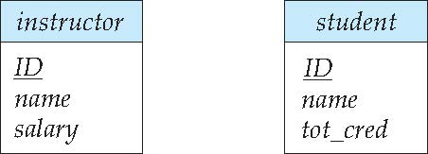
Representing Entity sets in ER Diagram
Entity sets can be represented graphically as follows:
Rectangles represent entity sets.
Attributes listed inside entity rectangle
Underline indicates primary key attributes

Slide 54
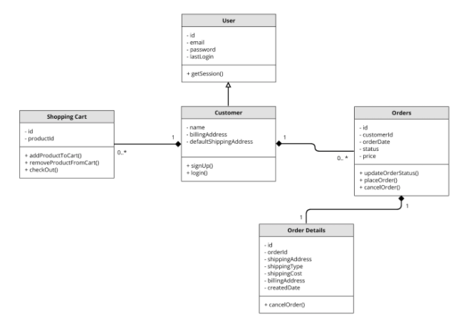
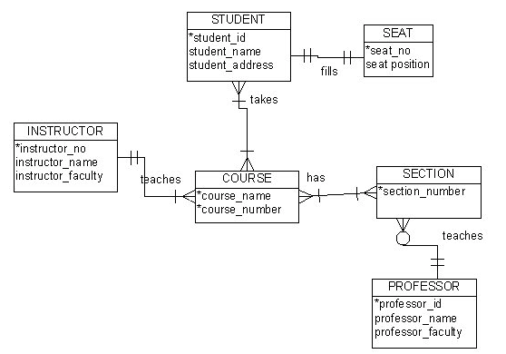
Visual Notation – Many Notations
ER Model
UML
“Other,” i.e. PowerPoint is the most common modeling notation.
It is easy to get “carried away.”
The trick is to do “just enough modeling.”
I mostly use Crow’s Foot
It is “just enough”
But lacks some capabilities.
The book uses ER notation.
Crow’s Foot

Slide 55
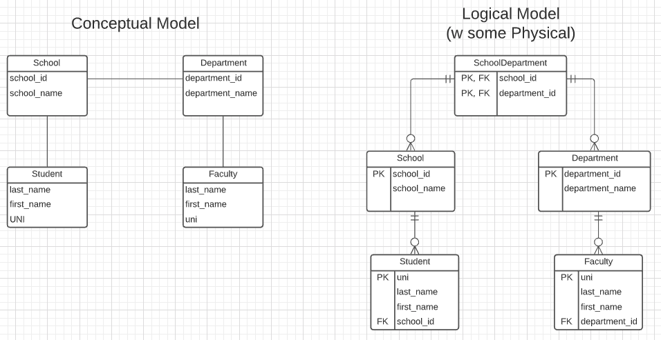
First Iteration/Step for University Data Model
This is the level of detail I want when I ask for:
Conceptual Model diagram.
Logical Model diagram.
Some online tools with “free,” constrained usage.
Lucidchart (https://www.lucidchart.com/)
Vertabelo (https://vertabelo.com/)
The model has:
Four entity sets: School, Department, Student, Faculty
Three relationship sets: Student-School, School-Department, Faculty-Department.

Slide 56
Entity Sets -- instructor and student
DFF Comments: Just a reminder of a previous slide.

Slide 57
Relationship Sets
A relationship is an association among several entities
Example: 44553 (Peltier) advisor 22222 (Einstein) student entity relationship set instructor entity
A relationship set is a mathematical relation among n ≥ 2 entities, each taken from entity sets
{(e₁, e₂, … e_{n}) | e₁ ∈ E₁, e₂ ∈ E₂, …, e_{n} ∈ E_{n}} where (e₁, e₂, …, e_{n}) is a relationship
Example:
(44553,22222) ∈ advisor
DFF Comments:
Nobody thinks about relationships this way.
There is no idea so simple that a DB professor cannot make it confusing, usually by using math.

Slide 58
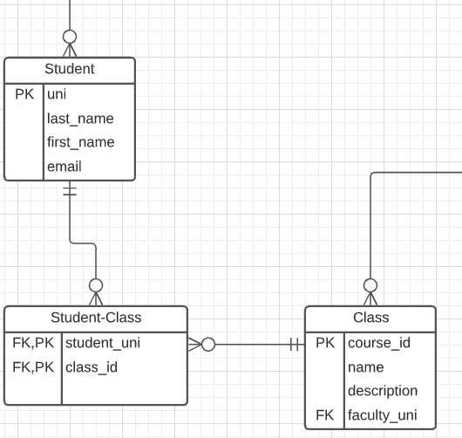
Relationship Sets (Cont.)
Example: we define the relationship set advisor to denote the associations between students and the instructors who act as their advisors.
Pictorially, we draw a line between related entities.
DFF Comments:
Nobody draws the diagrams this way, but ...
Sometimes thinking this way helps understand other ways to depict the concept.
(dff9, W4111)

Slide 59
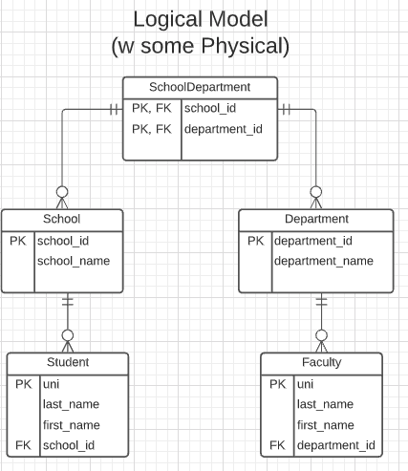
Notation has Precise Meaning
Attribute annotations:
PK = Primary Key
FK = Foreign Key
Line annotations:
We will learn over time and there are good tutorials (https://www.lucidchart.com/pages/er-diagrams) to help study and refresh.
We will spend a lot of time discussing keys.
We will start in a couple of slides.

Slide 60
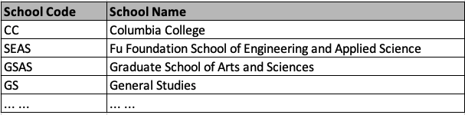
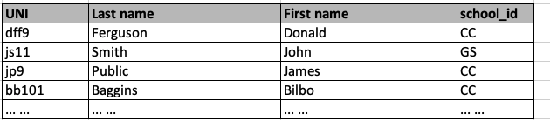
What Does this Mean? Let’s Get Started
Primary Key means that the value occurs at most once.
Foreign Key means that if a value occurs in school_id for any row, there must be a row in School with that key.
The line notations mean:
A student is related to EXACTLY ONE school.
A School may be related to 0, 1 or many students.

Slide 61
ER model -- Database Modeling
The ER data mode was developed to facilitate database design by allowing specification of an enterprise schema that represents the overall logical structure of a database.
The ER data model employs three basic concepts:
entity sets,
relationship sets,
attributes.
The ER model also has an associated diagrammatic representation, the ER diagram, which can express the overall logical structure of a database graphically.
DFF Comments:
The book and slides do not do a great job of motivating the ER model or ER diagrams.
Why do people and teams think about or use the ER model and modeling?

Slide 62

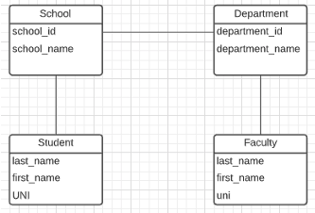
ER Model and ER Modeling
ER Model
Generalization
ER Model: Agility, Separation of Concerns
ER model is a generalization that most DB models implement in some form.
Using the ER model enables:
Thinking about and collaborating on design with getting bogged down in details.
Enable flexible choices about how to realize/Implement data.
ER Diagrams: Communication, Quality, Precision
With a little experience, everyone can understand and ER diagram.
Easier to discuss and collaborate on application’s data than showing SQL table definitions, JSON, ... ...
People think visually. That is why we have whiteboards. ER diagrams are precise and unambiguous.
Guides you to think about relationships, keys, ... And prevents “re-dos” later in the process. It is easier to fix a diagram than a database schema.
Specialization
Relational
Doc Model
Graph Model
... ...
UI UX
Business Professional
Business Service Developer
DB Pros

Slide 63
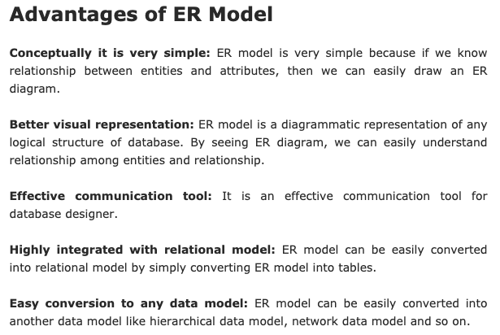
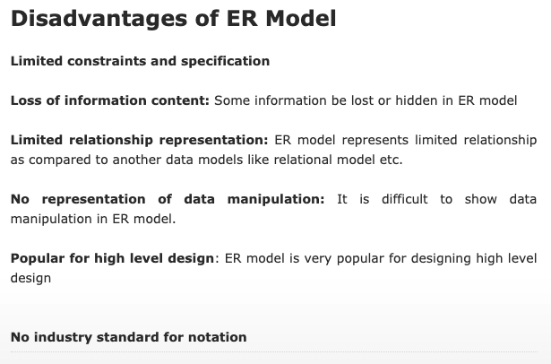
ER Modeling – Reasonably Good Summary
https://pctechnicalpro.blogspot.com/2017/04/advantages-disadvantages-er-model-dbms.html
Note:
If you get to use Google to help with take home exams, HW, etc.
I get to use Google to help with slides.

Slide 64
The Relational Model
64 | COMS W4111_002_2021_3: Lecture 1: Introduction, Course Overview, Foundational Concepts © Donald F. Ferguson, 2021

Slide 65
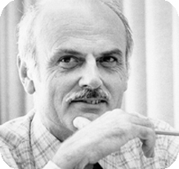
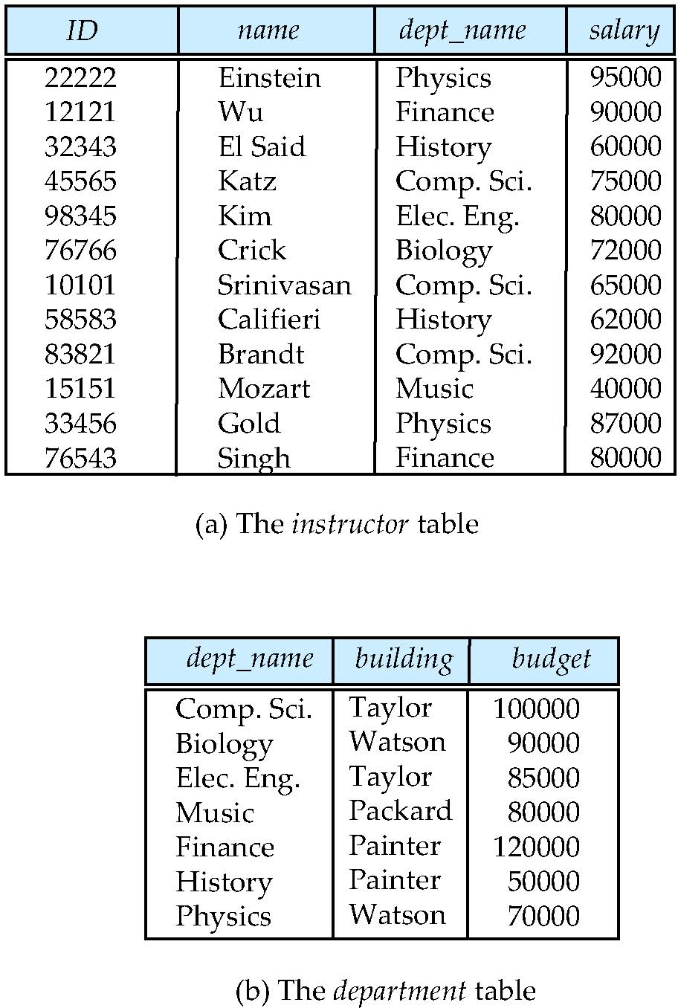
Relational Model
All the data is stored in various tables.
Example of tabular data in the relational model
Columns
Ted Codd Turing Award 1981
The “relation” is the “table.”
In my big space of pieces of data. ID, name, dept_name, salary are somehow related.
This causes confusion, because the ER and other models use “relation” to mean something else.
Core concepts:
Relation
Tuple (Row)
Column (Attribute)
Rows
Notes:
65

Slide 66
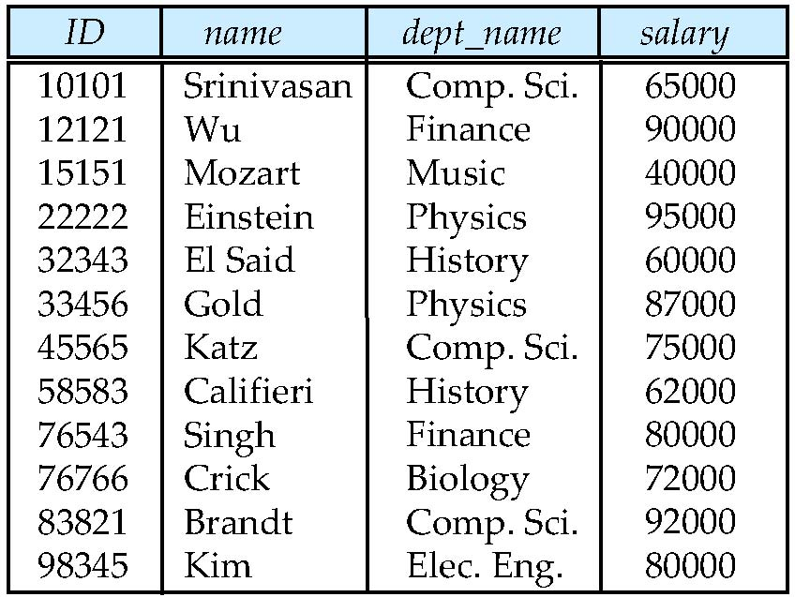
Example of a Instructor Relation
attributes
(or columns)
tuples
(or rows)

Slide 67
Attribute
The set of allowed values for each attribute is called the domain of the attribute
Attribute values are (normally) required to be atomic; that is, indivisible
The special value null is a member of every domain. Indicated that the value is “unknown”
The null value causes complications in the definition of many operations
DFF Comments:
I will explain the importance of atomic attributes and null in examples.
Atomic and use of Null is important?

Slide 68
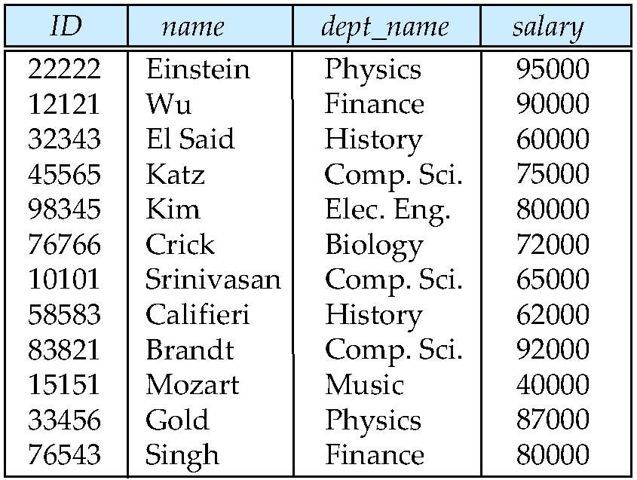
Relations are Unordered
Order of tuples is irrelevant (tuples may be stored in an arbitrary order)
Example: instructor relation with unordered tuples

Slide 69
Database Schema
Database schema -- is the logical structure of the database.
Database instance -- is a snapshot of the data in the database at a given instant in time.
Example:
schema: instructor (ID, name, dept_name, salary)
Instance:

Slide 70
Keys
Let K ⊆ R
K is a superkey of R if values for K are sufficient to identify a unique tuple of each possible relation r(R)
Example: {ID} and {ID,name} are both superkeys of instructor.
Superkey K is a candidate key if K is minimal Example: {ID} is a candidate key for Instructor
One of the candidate keys is selected to be the primary key.
which one?
Foreign key constraint: Value in one relation must appear in another
Referencing relation
Referenced relation
Example: dept_name in instructor is a foreign key from instructor referencing department

Slide 71
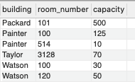
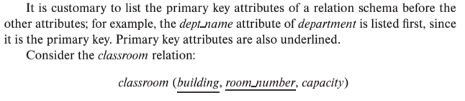
Notation
Classroom relation
classroom schema
Columns (Attributes)
Relation Name
Primary Key Columns
The primary key is a composite key. Neither column is a key (unique) by itself.
Keys are statements about all possible, valid tuples and not just the ones in the relation.
Capacity is unique in this specific data, but clearly not unique for all possible data.
In this domain, there cannot be two classrooms with the same building and room number.
Relation schema:
Underline indicates a primary key column. There is no standard way to indicate other types of key.
We will use bold to indicate foreign keys.
You will sometimes see things like classroom(building:string, room_number:number, capacity:number)

Slide 72
Observations
Keys:
Will be baffling. It takes time and experience to understand/appreciate.
There are many, many types of keys with formal definitions.
I explain the formality but focus on the concepts and applications.
No one uses the formal, relational model. So, why do we study it?
Is very helpful when understanding concepts that we cover later in the course, especially query optimization and processing.
There are many realizations of the model and algebra, and understanding the foundation helps with understanding language/engine capabilities.
The model has helped with innovating new approaches, and you may innovate in data and query models in your future.

Slide 73
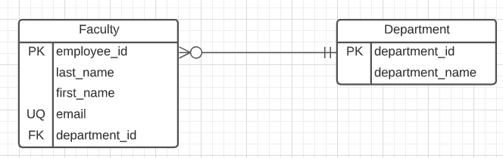
Start Building our Datamodel
First two relations:
Departments(title, id)
Faculty(employee_id, first_name, last_name, email, department_id)
Note:
email is almost certainly a candidate key.
A primary key is chosen arbitrarily. Why did I use employee_id?
Heuristic: People may change emails. I may lose “identity” in the data over time. Same person but two different emails.
employee_id is immutable. I cannot change.
ER Diagram:
Note: “UQ” is my non-standard convention.
Relationship:
A faculty “has” exactly one department.
A department as 0, 1 or many faculty.

Slide 74
Start Building our Datamodel
First two relations:
Departments(title, id)
Faculty(employee_id, first_name, last_name, email, department_id)
Note:
email is almost certainly a candidate key.
A primary key is chosen arbitrarily. Why did I use employee_id?
Heuristic: People may change emails. I may lose “identity” in the data over time. Same person but two different emails.
employee_id is immutable. I cannot change.
ER Diagram:
Note: “UQ” is my non-standard convention.
Relationship:
A faculty “has” exactly one department.
A department as 0, 1 or many faculty.
OK, that is interesting, but ... ...
Where does the data come from?
Users enter and update data through an application.
You can import pre-existing data.
You can generate test data.
How do you “manipulate” the data (CRUD)
Create.
Retrieve.
Update.
Delete.

Slide 75
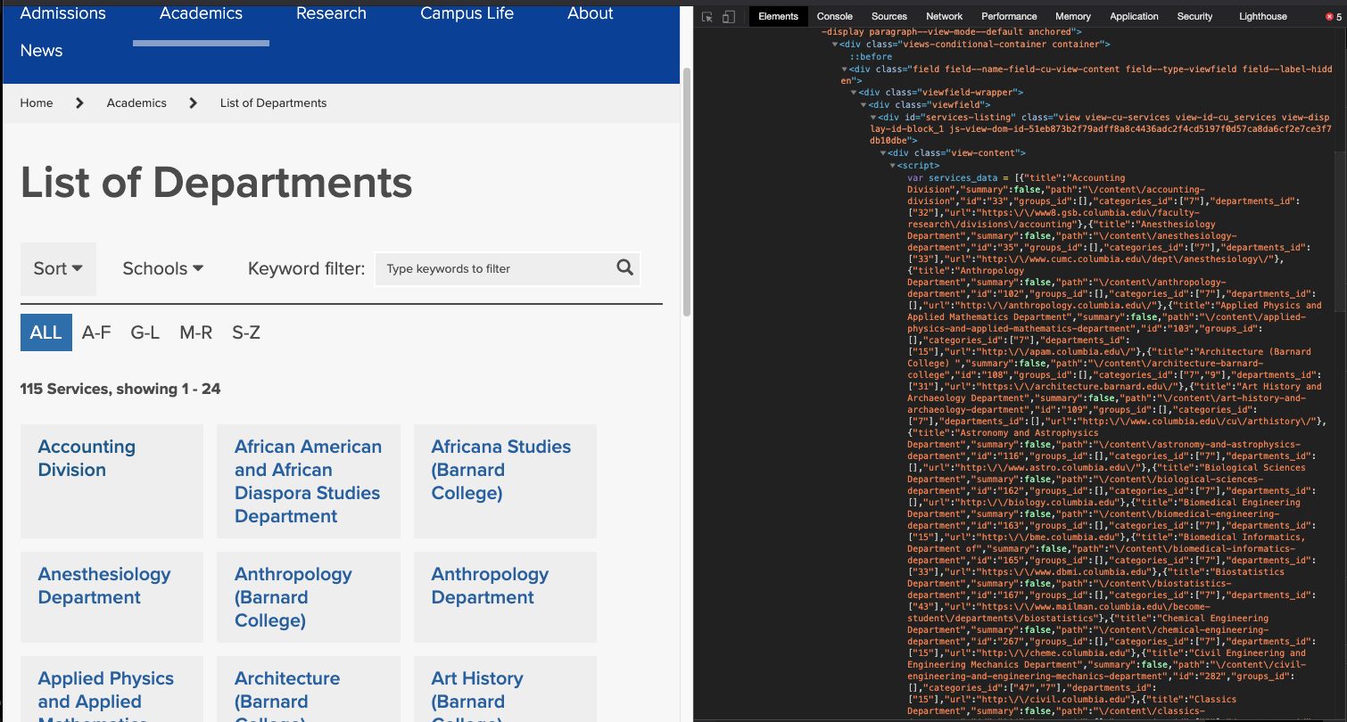
Import the Data – I screen-scraped the Website

Slide 76
Import the Data – I screen-scraped the Website
Switch to the notebook. (cu_info)

Slide 77
Comments
You probably have no idea what I just did.
I wanted to give you a feel for data engineering. You saw some steps:
Find data from various sources.
Convert data into a format you can process.
Perform transformation, links, etc.
Save the data.
This is often (historically) called Extract-Transform-Load (ETL)
You are now ready to start integrating with other data.
These steps enable analysis.
These are some of things we will do in the non-programming track to enable more complex data science, etc.

Slide 78
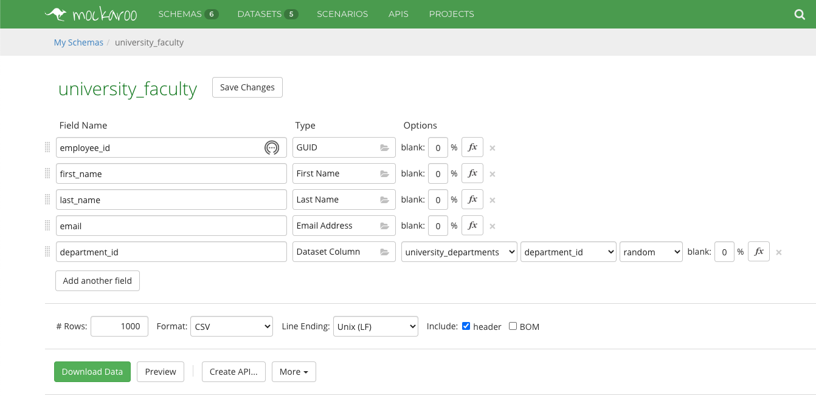
Generate Test Data – I Used to Tool

Slide 79
Relational Query Languages
Procedural versus non-procedural, or declarative
“Pure” languages:
Relational algebra
Tuple relational calculus
Domain relational calculus
The above 3 pure languages are equivalent in computing power
We will concentrate in this chapter on relational algebra
Not turning-machine equivalent
Consists of 6 basic operations
DFF Comments:
You will sometimes see other operator, e.g. ← Assignment.
Relational algebra focuses on retrieve. You can sort of do Create, Update, Delete.
The SQL Language, which we will see, extends relational algebra.

Slide 80
Relational Algebra
A procedural language consisting of a set of operations that take one or two relations as input and produce a new relation as their result.
Six basic operators
select: σ
project: ∏
union: ∪
set difference: –
Cartesian product: x
rename: ρ

Slide 81
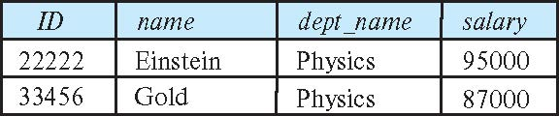
Select Operation
The select operation selects tuples that satisfy a given predicate.
Notation: σ _{p} (r)
p is called the selection predicate
Example: select those tuples of the instructor relation where the instructor is in the “Physics” department.
Query
σ _{dept_name=“Physics”} (instructor)
Result

Slide 82
Select Operation (Cont.)
We allow comparisons using
=, ≠, >, ≥. <. ≤
in the selection predicate.
We can combine several predicates into a larger predicate by using the connectives:
∧ (and), ∨ (or), ¬ (not)
Example: Find the instructors in Physics with a salary greater $90,000, we write:
σ _{dept_name=“Physics”} ∧ _{salary} > 90,000 (instructor)
Then select predicate may include comparisons between two attributes.
Example, find all departments whose name is the same as their building name:
σ _{dept_name=building} (department)

Slide 83
Project Operation
A unary operation that returns its argument relation, with certain attributes left out.
Notation:
∏ _{A1,A2,A3 ….Ak} (r)
where A₁, A₂ are attribute names and r is a relation name.
The result is defined as the relation of k columns obtained by erasing the columns that are not listed
Duplicate rows removed from result, since relations are sets

Slide 84
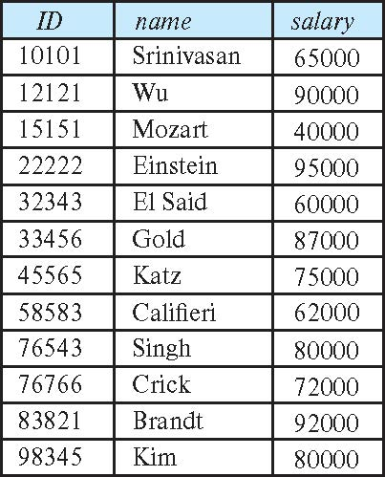
Project Operation (Cont.)
Example: eliminate the dept_name attribute of instructor
Query: ∏_{ID, name, salary} (instructor)
Result:

Slide 85
Composition of Relational Operations
The result of a relational-algebra operation is relation and therefore of relational-algebra operations can be composed together into a relational-algebra expression.
Consider the query -- Find the names of all instructors in the Physics department.
∏_{name}(σ _{dept_name} _{=“Physics”} (instructor))
Instead of giving the name of a relation as the argument of the projection operation, we give an expression that evaluates to a relation.

Slide 86
Relax Calculator
Let’s look at an online tool that you will use.
RelaX (https://dbis-uibk.github.io/relax/calc/local/uibk/local/0)
The calculator:
Does have the sample data from the textbook.
You can also upload new data. (Show how and example)
Some queries:
σ title='Computer Science Department' ∨ title='Accounting Division' (departments)
π last_name, email (faculty)
π last_name, email ( σ department_id=165 ∨ department_id=1010 (faculty) )

Slide 87
SQL
87 | COMS W4111_002_2021_3: Lecture 1: Introduction, Course Overview, Foundational Concepts © Donald F. Ferguson, 2021

Slide 88
History
IBM Sequel language developed as part of System R project at the IBM San Jose Research Laboratory
Renamed Structured Query Language (SQL)
ANSI and ISO standard SQL:
SQL-86
SQL-89
SQL-92
SQL:1999 (language name became Y2K compliant!)
SQL:2003
Commercial systems offer most, if not all, SQL-92 features, plus varying feature sets from later standards and special proprietary features.
Not all examples here may work on your particular system.

Slide 89
SQL Parts
DML -- provides the ability to query information from the database and to insert tuples into, delete tuples from, and modify tuples in the database.
integrity – the DDL includes commands for specifying integrity constraints.
View definition -- The DDL includes commands for defining views.
Transaction control –includes commands for specifying the beginning and ending of transactions.
Embedded SQL and dynamic SQL -- define how SQL statements can be embedded within general-purpose programming languages.
Authorization – includes commands for specifying access rights to relations and views.

Slide 90
SQL Language Statements
The core SQL language statements are:
SELECT: Implements both σ, π
INSERT
UPDATE
DELETE
CREATE TABLE
ALTER TABLE
JOIN, which is an operator within SELECT.
Many, if not most, SQL statements:
Require multiple relational algebra expressions.
Cannot easily (or at all) be represented in relational algebra.
π last_name, email (
σ department_id=165 ∨ department_id=1010 (faculty)
)
=
SELECT last_name, email FROM faculty WHERE department_id=165 or
department_id=1019

Slide 91
Data Definition Language
The SQL data-definition language (DDL) allows the specification of information about relations, including:
The schema for each relation.
The type of values associated with each attribute.
The Integrity constraints
The set of indices to be maintained for each relation.
Security and authorization information for each relation.
The physical storage structure of each relation on disk.

Slide 92
Create Table Construct
An SQL relation is defined using the create table command:
create table r
(A₁ D₁, A₂ D₂, ..., A_{n} D_{n}, (integrity-constraint₁), ..., (integrity-constraint_{k}))
r is the name of the relation
each A_{i} is an attribute name in the schema of relation r
D_{i} is the data type of values in the domain of attribute A_{i}
Example:
create table instructor ( ID char(5), name varchar(20), dept_name varchar(20), salary numeric(8,2))

Slide 93
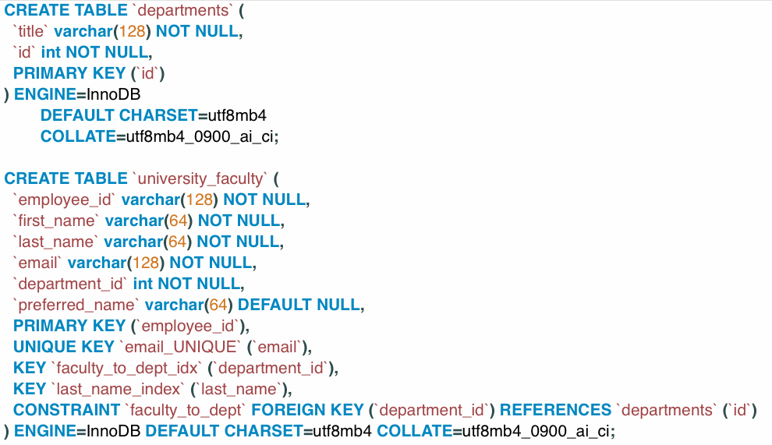
SQL Create Table for our Datamodel
The ` (back tick) is optional in most cases.
You can look up the various column types.
INT is an integer.
VARCHAR(N) is a variable length string with maximum length 128.
DEFAULT CHARSET, ENGINE, COLLATE are MySQL specific and you can usually ignore.
NOT NULL is a Constraint. Constraints are core parts of SQL and we will cover in detail.
Keys/Constraints/Index
You can see PRIMARY KEY definition.
UNIQUE KEY is similar to Candidate Key. UNIQUE KEY and the columns NOT NULL is a Candidate Key.
Foreign key defines source columns and reference columns.
“Key” sometimes means “Index” and is just used for performance.
Some databases conflate the concepts of Key and Index. We will cover both keys and indexes in detail.

Slide 94
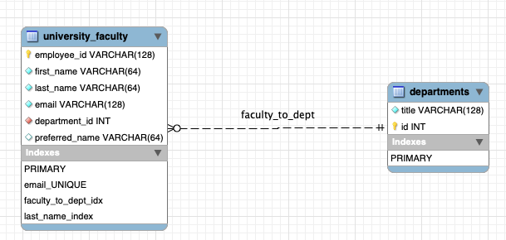
Crow’s Foot Like Physical Diagram
It is possible to draw a physical model in an ER Diagram tool and generate the CREATE TABLE statements.
I never to do.
I find it more trouble than it is worth.
I will reverse engineer an existing database to understand its schema.

Slide 95
Switch to Demos Jupyter Notebook and DataGrip
Drawing a simple data model in Lucidchart.
Generating sample data in Mockaroo.
Loading CSV data using DataGrip.
Editing and modifying schema in SQL.
Running some queries.
Doing some relational algebra.

